Slide 1

INSTITUTE :UIE
DEPARTMENT: ALL ACADEMIC UNITS
Bachelor of Engineering (All Sections)
Subject Name and Code:
Engineering Physics 23SPH-141
Prepared by: Dr. Anjana Sharma, Assistant Prof. Physics
CRYSTALLOGRAPHY & ULTRASONICS
DISCOVER . LEARN . EMPOWER

Slide 2
COURSE OBJECTIVES
The course is designed to make the students industry ready to contribute in the growing demand of the industry at local, national and international level.
It will make the students competent to understand basic concepts and applications of advanced engineering physics and apply its principles in their respective fields at global platform.
It will enhance the skill level of the students and shall make them preferred choice for getting employment in industry and research labs.
It will give thorough knowledge of the discipline to enable students to disseminate knowledge in pursuing excellence in academic areas.

Slide 3
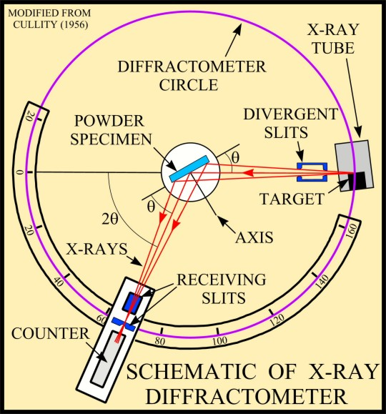
COURSE OUTCOMES
CO Number | Title On completion of this course, the students are expected to learn | Level
CO1 | Quote the basic fundamental concepts of lasers, optical fibres, crystallography, ultrasonic oscillations, semiconductor physics, quantum mechanics and nanotechnology. | Remember, Understand
CO2 | Demonstrate the working of various lasers, fibre components, semiconductor devices; explain the behaviour of crystalline solids, quantum and nano-scale systems. | Understand
CO3 | Solve problems by applying principles related to lasers, fibres, semiconductors, oscillations, quantum and nanoscience. | Applying
CO4 | Compare various lasers and fibres, semiconducting devices, crystalline materials, structures at quantum and nanoscale on the basis of their properties for industrial applications. | Analyze
CO5 | Develop various systems using lasers, fibres, semiconductors and nanomaterials for futuristic applications. | Design
Fig. 1 Introduction [1]

Slide 4
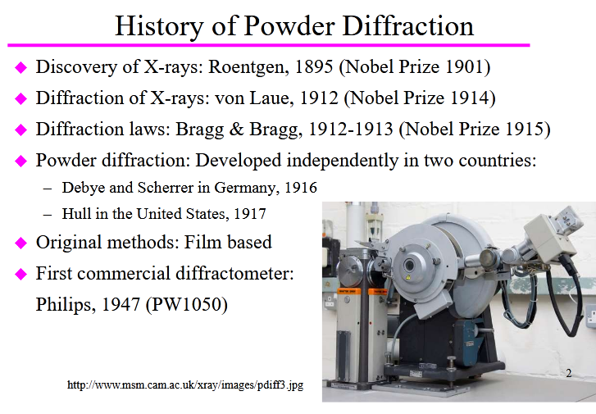
HISTORY OF POWDER METHOD
Fig. 2 Instrument [2]

Slide 5
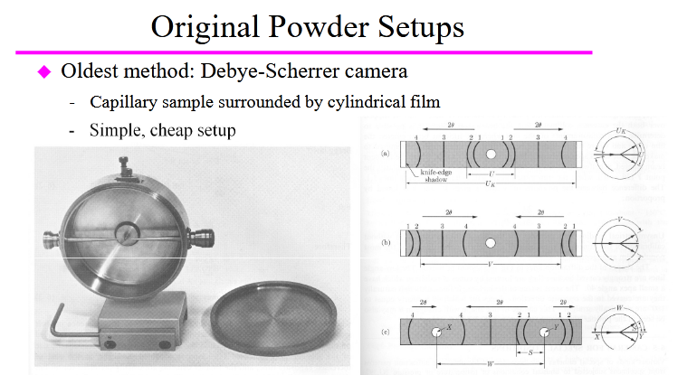
ORIGINAL POWDER SETUPS
Fig. 3 Instrument [2]

Slide 6
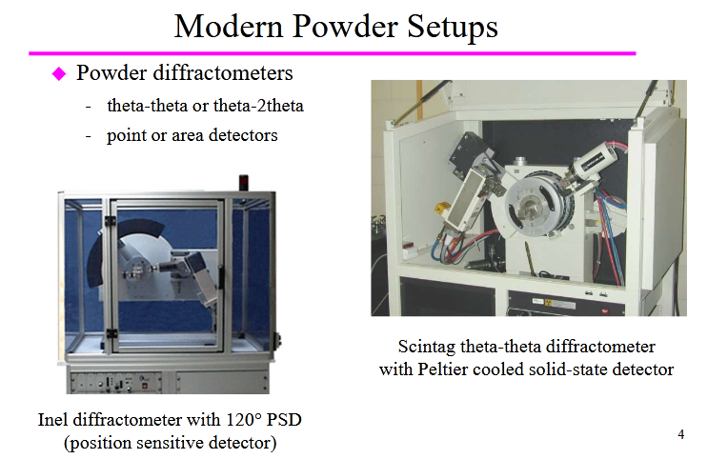
MODERN POWDER SETUPS
Fig. 4 Instrument [2]

Slide 7
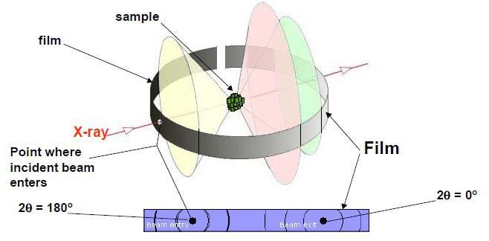
POWDER DIFFRACTION METHOD
Powder diffraction is a scientific technique using X-ray, neutron, or electron diffraction on powder or microcrystalline samples for structural characterization of materials. An instrument dedicated to performing such powder measurements is called a powder diffractometer.
Fig. 5 Introduction [3]

Slide 8
PROCESS
A is a source of X- rays. These X-rays are generated by a cathode ray tube.
X-rays are filtered by monochromator to produce monochromatic radiation. It help to choose the correct wavelength.
Slits (S₁ and S₂) are used to adjust the shape of the beam, collimate to concentrate and direct the X-rays beam toward the sample so that the powdered specimen (P) get a narrow pencil of X-rays.
Fine powder is struck on a hair by means of gum. It is suspended vertically in the axis of a cylindrical camera. This enables sharp lines to be obtained on the photographic film which is surrounding the powder crystal in the form of a circular arc.

Slide 9
PROCESS
The X-rays after falling on the powder passes out of the camera through a cut in the film so as to minimize the fogging produced by the scattering of the direct beam.
When the geometry of the incident X-rays impinging the sample satisfies the Bragg Equation, constructive interference occurs and the intensity of the reflected X-rays is recorded by a detector.
The detector also processes this X-ray signal and convert it into a count rate, which is then output to a device such as a printer or computer monitor.
In a more complicated apparatus, also a goniometer can be used for fine adjustment of the sample and the detector positions.

Slide 10
SCHEMATIC OF X-RAY DIFFRACTOMETER
Fig. 6 Diffractometer[1]

Slide 11
OBTAINING DATA
The crystal structure can be obtained from the arrangement of the traces and their relative intensities.
A diffraction pattern plots intensity against the angle of the detector, 2θ. The result obtained is called diffractogram.
In a diffraction pattern, the peak position depends upon the wavelength.
Absolute intensity (number of X-rays observed in an given peak) may vary by instrumental and experimental parameters.

Slide 12
APPLICATIONS AND LIMITATIONS
Applications
1. X-ray powder diffraction is most widely used for the identification of unknown crystalline materials (e.g. minerals, inorganic compounds).
2. Determination of unknown solids is critical to studies in geology, environmental science, material science, engineering and biology.
Limitation:-
1. Crystal structure determination from powder diffraction data is extremely challenging due to the overlap of reflections in a powder experiment.

Slide 13
SUMMARY
Introduction to Powder Method
Working of Powder Method
Advantages and Disadvantages
Application

Slide 14
FAQS
What is difference between Powder and Laue method?
What is X-ray?
Why powder method is more beneficial than Laue method?
List advantages and disadvantages of Laue Method
What is the significance of Bragg’s law?
What is inverse piezoelectric method?
Draw plane of (100)

Slide 15
REFERENCES
Reference Website
[1] https://www.spec2000.net/00-login-1.htm
[2] https://slidetodoc.com/introduction-to-powder-x-ray-diffraction-18-th/
[3] https://physics.stackexchange.com/questions/193802/x-ray-diffraction-on-thin-film
[4] https://serc.carleton.edu/research_education/geochemsheets/techniques/XRD.html
[5]]file:///C:/Users/admin/Desktop/PowderMethodsHandout.pdf
[6] http://prism.mit.edu/xray/Basics%20of%20X-Ray%20Powder%20Diffraction.pdf
[7] https://en.wikipedia.org/wiki/Powder_diffraction
[8] file:///C:/Users/admin/Downloads/crystals-07-00142.pdf
[9] http://ww1.iucr.org/iucr-top/comm/cteach/pamphlets/2/node8.html
[10] https://www.youtube.com/watch?v=rImvmfjl2-E
[11] https://www.youtube.com/watch?v=ieYucsUlBqo

Slide 16
THANK YOU
For queries
Email: anjana.uis@cumail.in

